Slide 1
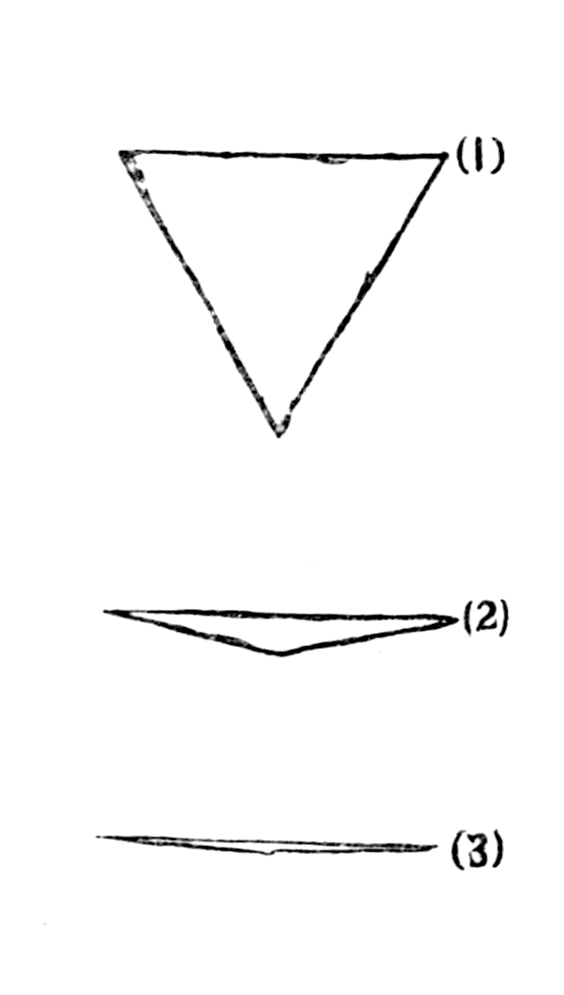

Simon Mikulcik
http://commons.wikimedia.org/wiki/File:Flatland_%28first_edition%29_page_100.png
http://commons.wikimedia.org/wiki/File:Flatland_%28first_edition%29_page_4.png

Slide 2
Some of Abbott’s Messages
Understand Subtle Differences in Class Distinctions
Stretch you Imagination to Visualize New Worlds

Slide 3
Let’s Make a Video Game
Visually ‘see’ what Flatlanders see
Immerse yourself into the world of Flatland
Understand the troubles of seeing only one dimension
Games are FUN!

Slide 4
Lighting Model in Flatland
Globally Illuminated (“equally at all times and in all places”) (19)
Presence of Fog
Inhabitants have “luminous edges” (15)

Slide 5
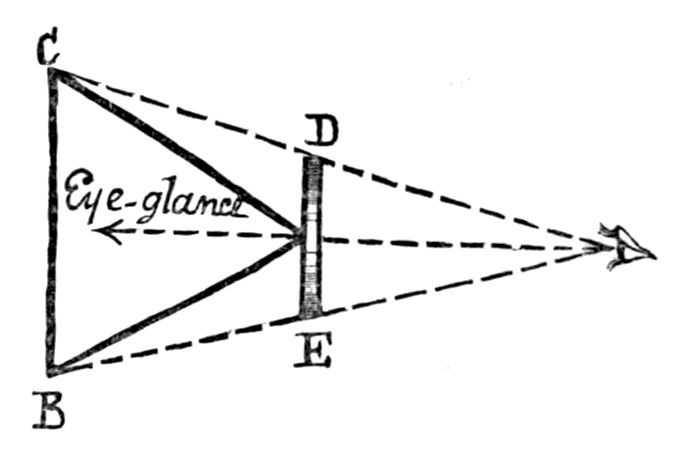
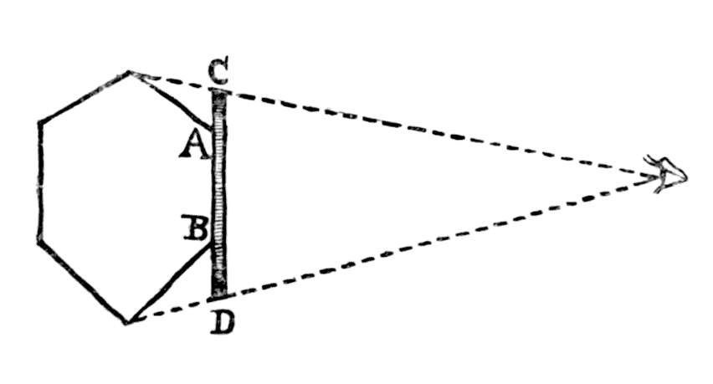
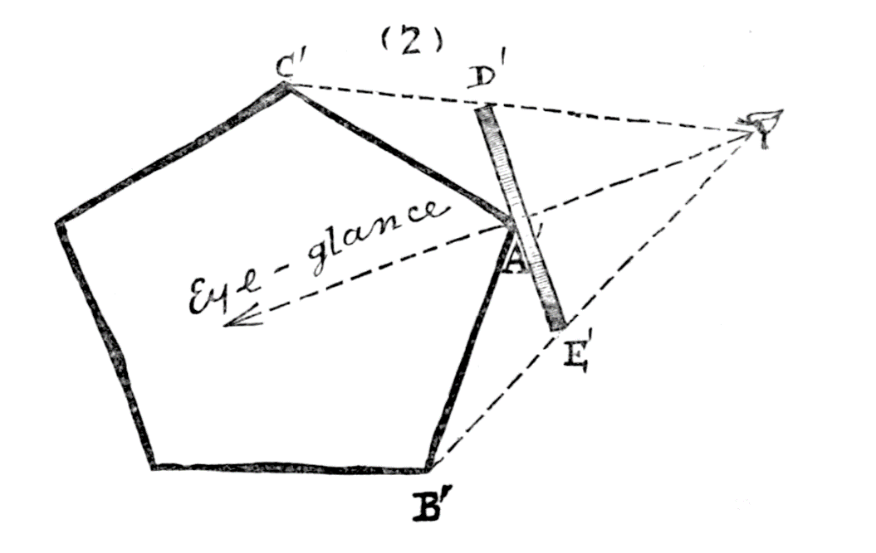
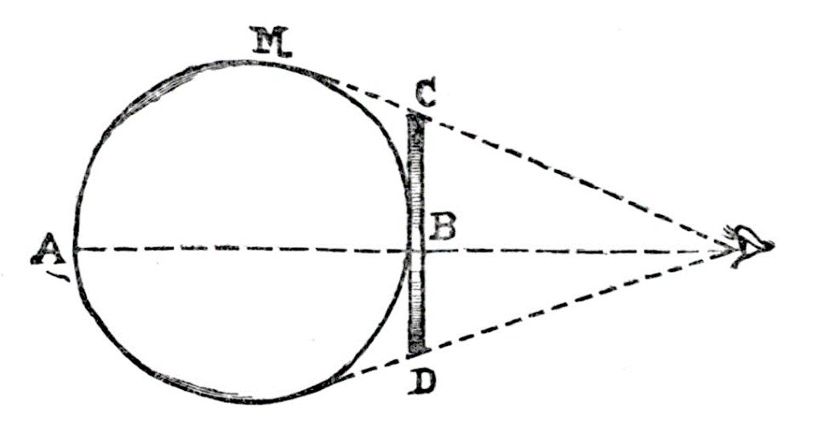
http://commons.wikimedia.org/wiki/File:Flatland_(first_edition)_page_23b.png
http://commons.wikimedia.org/wiki/File:Flatland_(first_edition)_page_23a.png
http://commons.wikimedia.org/wiki/File:Flatland_(first_edition)_page_36.png
http://commons.wikimedia.org/wiki/File:Flatland_(first_edition)_page_24.png

Slide 6




Enlarged View of Book Images
Triangle
Pentagon
Hexagon
Circle
These images are from the previous slide’s images

Slide 7



Images from my Project
Triangle
Pentagon
Hexagon
Circle

Slide 8
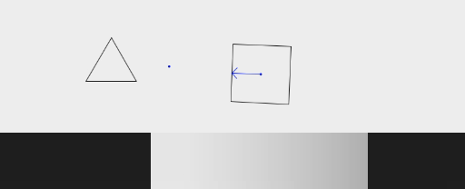

Slide 9
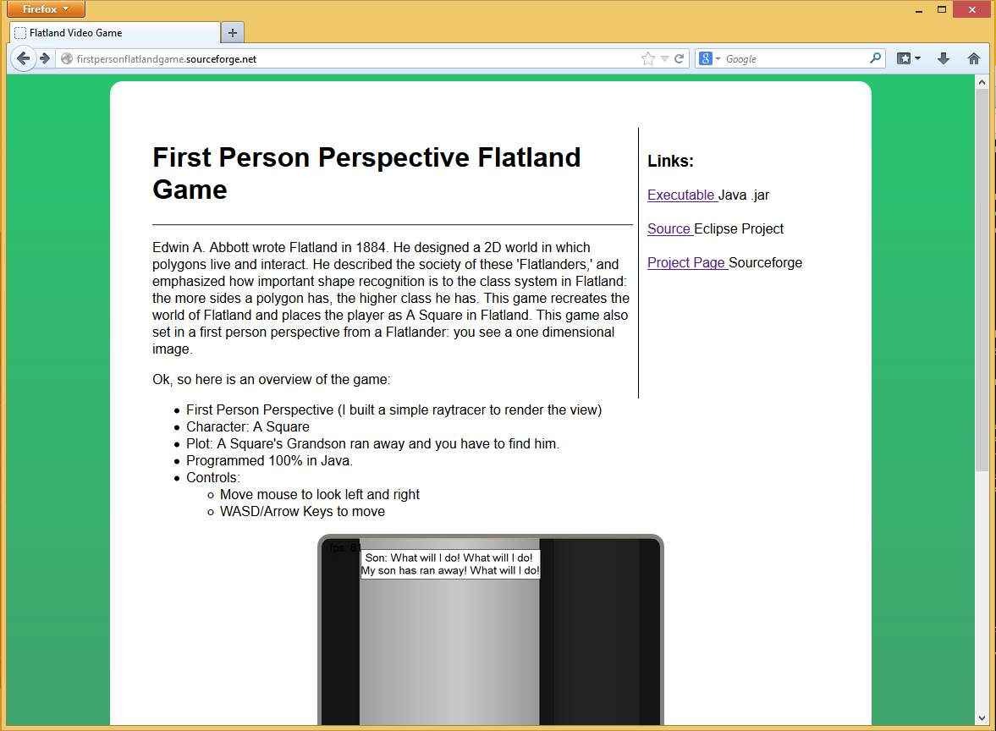
Want to Try it out?
FirstPersonFlatlandGame.sourceforge.net

